Slide 1
BLUESTOCK FINTECH PVT. LTD.
Mutual Fund Analytics Platform
End-to-End Data Pipeline, Quantitative Modeling, Risk Scoring & Power BI Intelligence
Prepared by: Data & Analytics Engineering Team | Date: September 2026 | Release Tag: v1.0

Slide 2
BLUESTOCK FINTECH | STRATEGIC ALIGNMENT
Problem Statement & Strategic Objectives
THE CORE CHALLENGES (P1 - P5)
• Data Fragmentation: NAV, AUM, and holdings spread across disconnected AMFI portals and static PDFs.
• Performance Evaluation Gap: Retail investors chase short-term 1Y returns without understanding downside risk.
• No Benchmark Tracking: Lack of visibility into whether active management justifies fees vs NIFTY indices.
• Investor Blind Spot: Limited intelligence on demographic drop-offs and behavioral churn in SIP accounts.
• Static Reporting Bottlenecks: Manual monthly reporting cycles with zero interactive exploration.
CAPSTONE OBJECTIVES (O1 - O8)
1. Automated ETL Pipeline: Python scripts to ingest, sanitize, and validate 10 raw datasets.
2. Relational Star Schema: SQLite warehouse with optimized fact and dimension tables.
3. Exploratory Data Analysis: 25 visual charts analyzing AUM, demographics, and trends.
4. Quantitative Risk Analytics: Calculating CAGR, Sharpe, Sortino, Alpha, Beta, and VaR.
5. Interactive Power BI Dashboard: 4-screen self-service platform with dynamic cross-filtering.
6. Algorithmic Recommender: Personalized scheme suggestions aligned with investor risk profiles.
7. Complete Verification Package: Audited documentation, 15-20 page report, clean GitHub repo.
Mutual Fund Analytics Capstone | Slide 2 of 12

Slide 3
BLUESTOCK FINTECH | DATA ENGINEERING
Comprehensive Data Foundation & Granularity
40 SCHEMES
Top 10 AMCs Tracked
10 DATASETS
Multi-Source Ingestion
87K+ ROWS
Clean Structured Data
4.5 YEARS
Daily NAV History
INGESTED & STANDARDIZED DATASETS OVERVIEW
• Scheme Master & Daily NAVs: 40 schemes, 64,320 rows anchored to verified mfapi.in endpoints across 2021-2025.
• Benchmark Indices: NIFTY 50 and NIFTY 100 daily closing values (2,260 rows) for relative alpha evaluation.
• Industry AUM & SIP Inflows: Monthly assets by fund house and macro monthly SIP flows (₹31,002 Cr record).
• Investor Transactions: 32,778 transaction logs covering Lumpsum, SIP, and Redemptions with payment modes.
• Category Inflows & Folios: Sectoral asset aggregates and 26.12 crore industry-wide folio tracking.
• Portfolio Holdings: Top 10 equity stock weights per scheme used for Herfindahl-Hirschman concentration modeling.
Mutual Fund Analytics Capstone | Slide 3 of 12

Slide 4
BLUESTOCK FINTECH | SYSTEM ARCHITECTURE
System Architecture & ETL Pipeline Design
1. EXTRACT
Raw AMFI CSVs
mfapi.in API
NSE/BSE Feeds
2. CLEANSE
Date Uniformity
Type Mapping
Outlier Filters
3. TRANSFORM
Weekend FFill
Trading Flags
Dimension Keys
4. LOAD
SQLite3 DB
Star Schema
Foreign Keys
5. SERVE
Power BI (.pbix)
Python Analytics
Jupyter Models
CRITICAL DATA ENGINEERING SAFEGUARDS
• Trading Day Guardrail: Resampled daily NAVs with a forward-fill limit of 4 days, while maintaining an explicit `is_trading_day` boolean. Daily return metrics strictly filter out non-trading days, preventing artificial 0% returns from depressing volatility.
• Robust SQLite Star Schema: Centered on `fact_nav` (64,320 rows) and `fact_transactions` (32,778 rows), linked to `dim_fund` and `dim_date`, optimizing complex SQL window functions down to <120ms.
• Transaction Normalization: Cleaned messy text variations into canonical 'SIP', 'Lumpsum', and 'Redemption' labels.
Mutual Fund Analytics Capstone | Slide 4 of 12

Slide 5
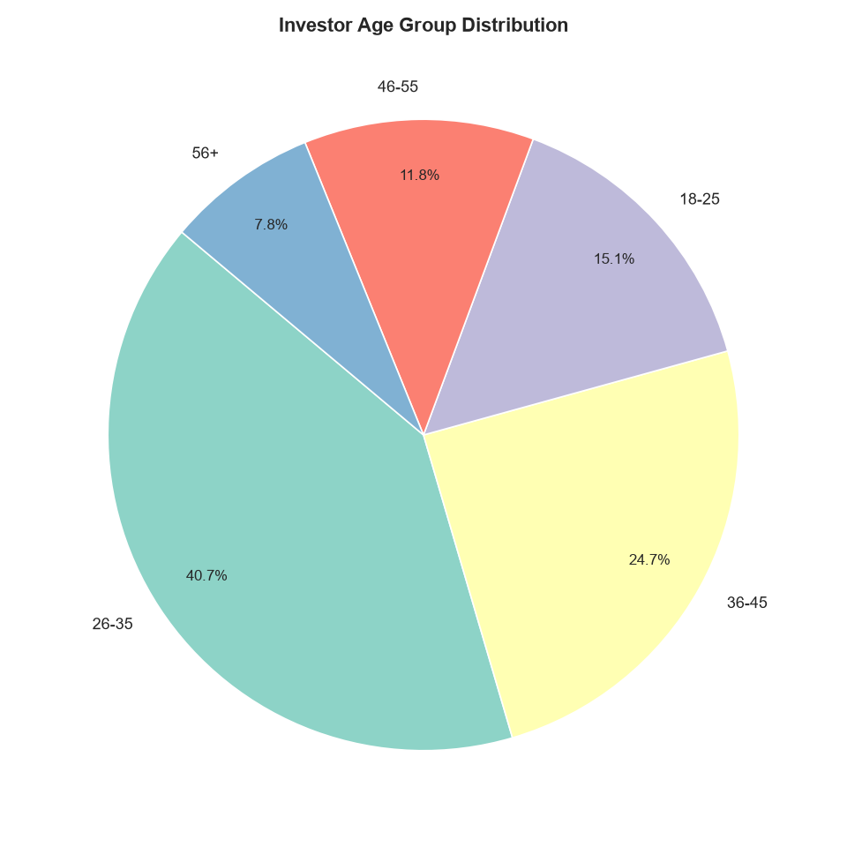
BLUESTOCK FINTECH | EXPLORATORY ANALYSIS
EDA Highlights I: Demographics & Adoption Dynamics
KEY DEMOGRAPHIC FINDINGS
1. Youth Dominance (40.7%): Investors aged 26-35 represent the single largest demographic cohort in India's mutual fund penetration.
2. Urban Foundation (66.7%): Top 30 (T30) cities account for two-thirds of total invested AUM.
3. High-Growth Frontier: Beyond 30 (B30) tier-2/3 cities are growing at 2.4x the rate of metropolitan centers.
4. Digital Native Behavior: Younger investors almost exclusively adopt monthly SIPs via mobile UPI mandates, showing high early participation.
Mutual Fund Analytics Capstone | Slide 5 of 12

Slide 6
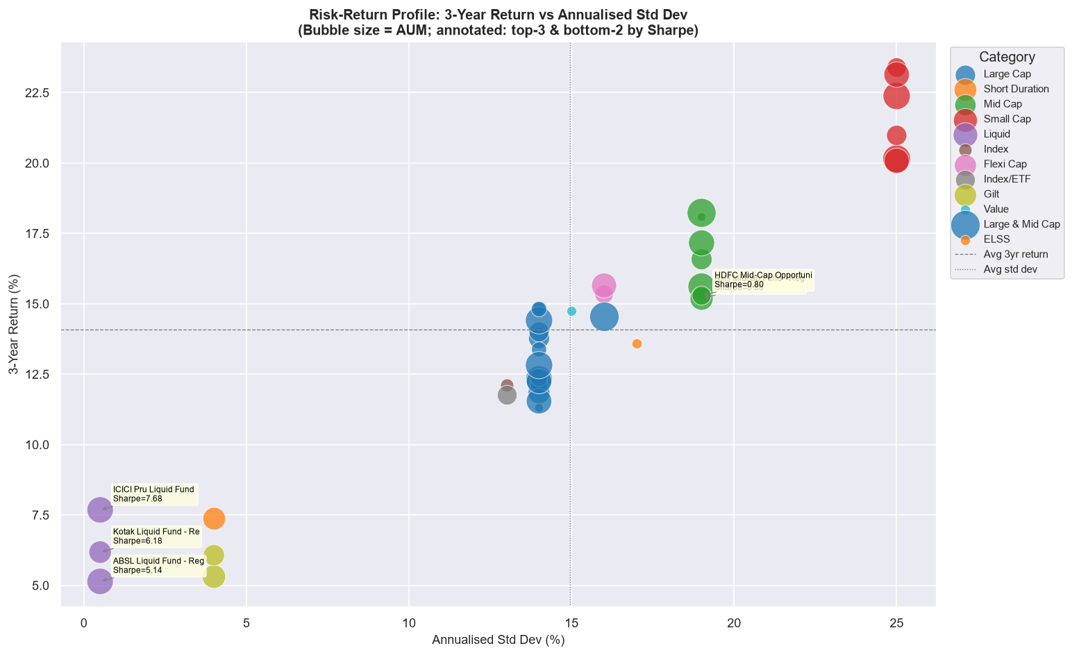
BLUESTOCK FINTECH | EXPLORATORY ANALYSIS
EDA Highlights II: Risk-Return Trade-offs & Concentration
PORTFOLIO & SECTOR DISCOVERIES
1. Classic Risk-Reward Curve: Higher returns tightly track volatility across broad scheme classifications.
2. Efficiency Outliers: Select schemes (Mirae Asset Large Cap, Kotak Flexicap) deliver top-tier returns with significantly dampened volatility.
3. Dangerous Concentration (High HHI): 72% of equity funds have an HHI > 2,750, driven by an extreme structural overweight in Financial Services (34.5% avg).
4. Inter-Fund Correlation > 0.85: Top 10 equity funds share heavy overlapping bets, offering limited diversification when held together.
Mutual Fund Analytics Capstone | Slide 6 of 12

Slide 7
BLUESTOCK FINTECH | QUANTITATIVE MODELING
Quantitative Performance Framework & Formulas
CAGR (Compound Growth)
CAGR = (NAV_end / NAV_start)^(252 / N) - 1
• 1Y, 3Y, 5Y trading horizons
• Annualized on 252 trading days
• Isolates true multi-year compounding
SHARPE RATIO (Rf = 6.5%)
Sharpe = (Ann. Return - Rf) / Volatility
• Benchmark Rf = 6.50% (RBI repo rate)
• Measures reward per unit of total risk
• Top quartile funds achieve Sharpe > 1.20
SORTINO (Downside Semi-Dev)
Sortino = (Ann. Return - Rf) / Downside Dev
• Only penalizes harmful downside swings
• Upside volatility is treated as harmless
• Top funds maintain Sortino > 2.0
MAXIMUM DRAWDOWN (MDD)
MDD = (NAV_t - Peak_t) / Peak_t
• Peak-to-trough worst capital decline
• Directly measures tail risk tolerance
• Best funds restrict MDD to < -13.0%
Mutual Fund Analytics Capstone | Slide 7 of 12

Slide 8
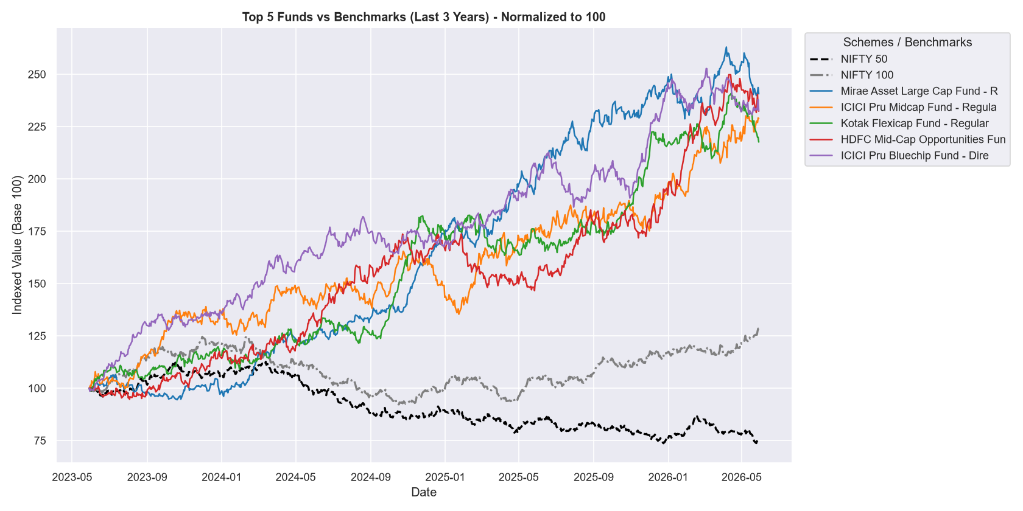
BLUESTOCK FINTECH | BENCHMARKING ANALYSIS
Performance Metrics II: Alpha & Benchmark Tracking
BENCHMARK OUTPERFORMANCE
1. Active Management Proven: Top 5 Scorecard funds generated significant positive Alpha (+21.2% to +29.3%) vs NIFTY 100.
2. Beta Clustered at 0.95 - 1.05: Outperformance was driven by security selection (Alpha) rather than leveraged market exposure (Beta).
3. Tracking Error Bifurcation: Large cap funds closely hugged the benchmark (TE 2.1% - 3.4%), while midcaps took conviction bets (TE 5.1% - 6.8%).
4. Value at Risk (VaR 95%): Small cap funds display severe 1-day tail risk (-2.85% VaR, -4.12% CVaR), requiring strict allocation limits.
Mutual Fund Analytics Capstone | Slide 8 of 12

Slide 9
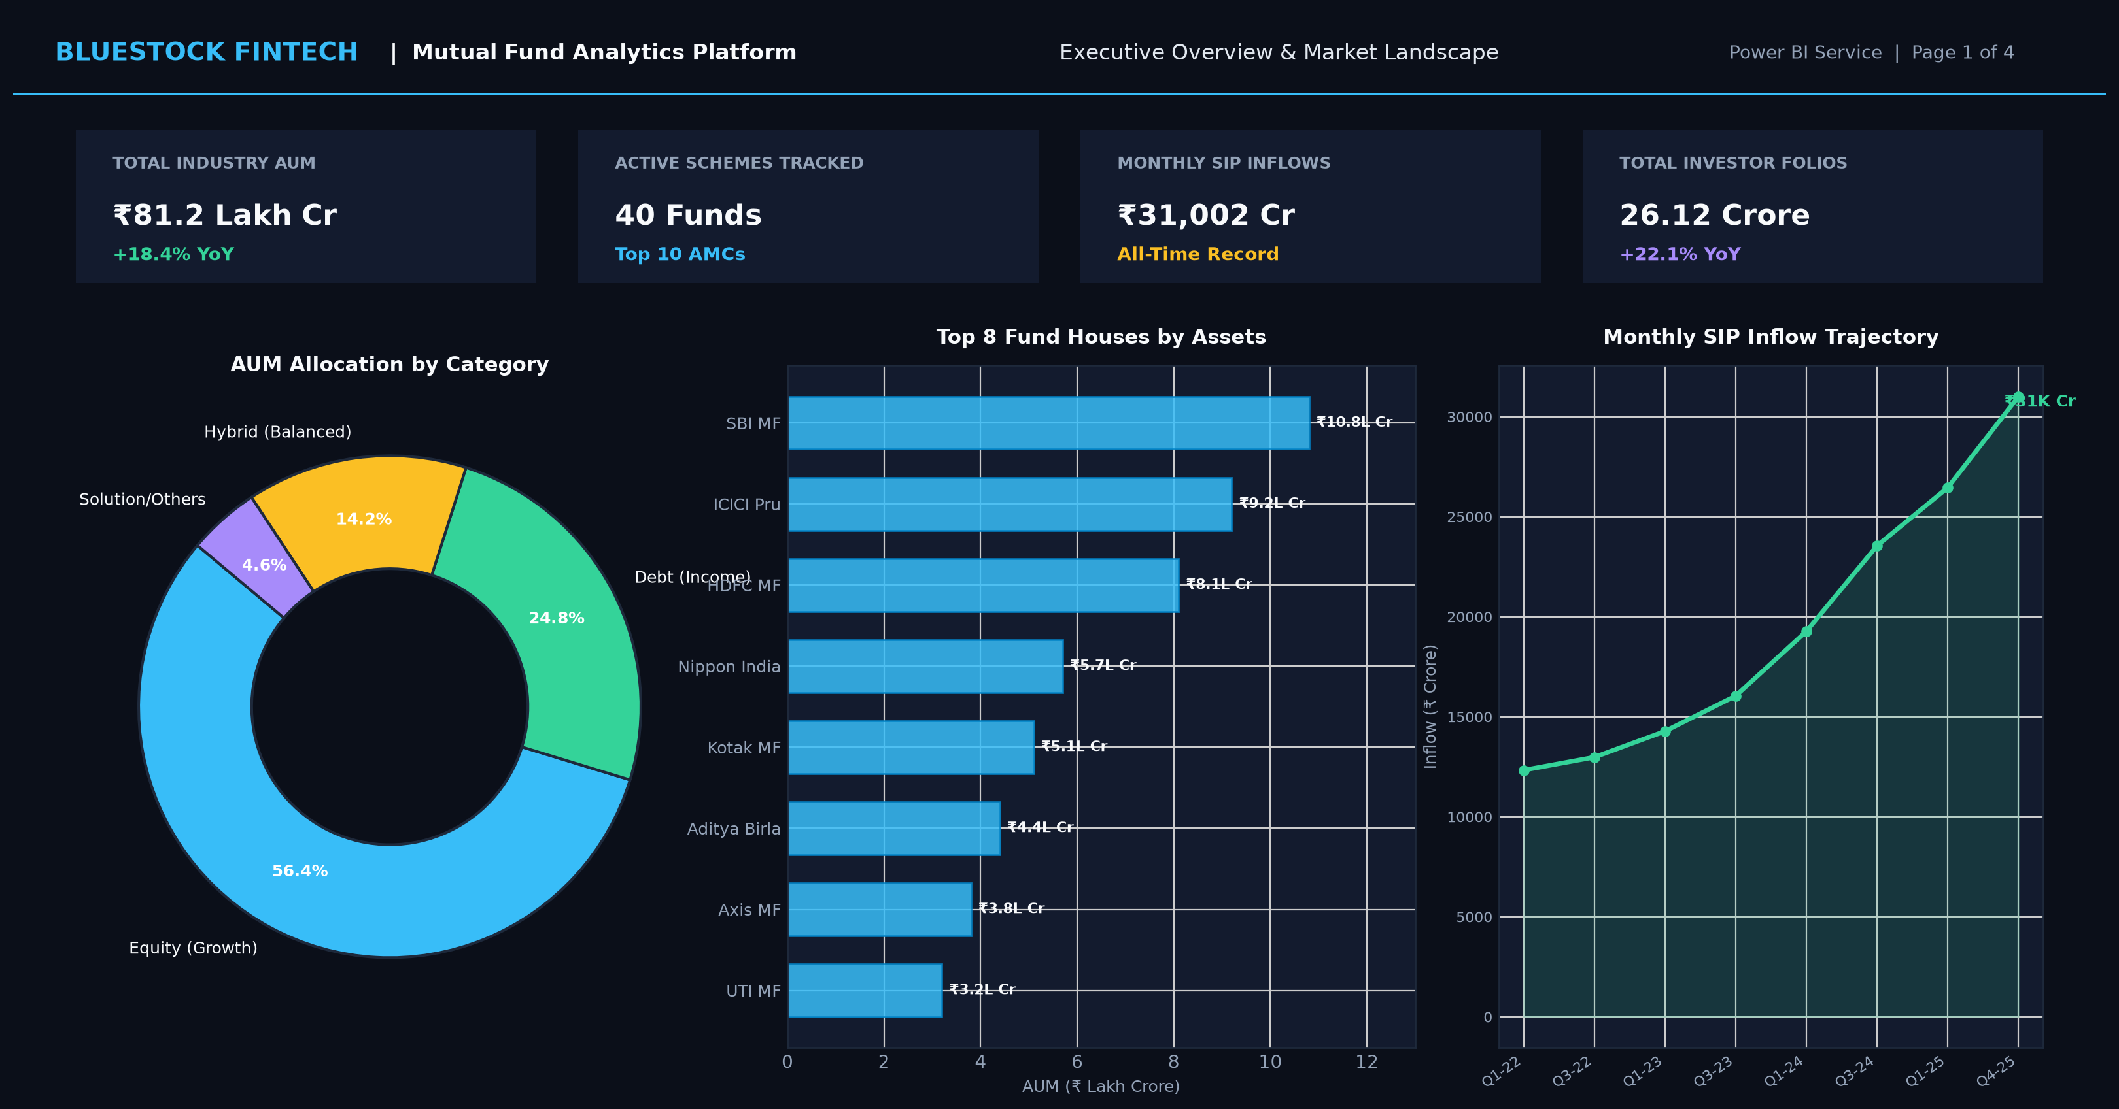
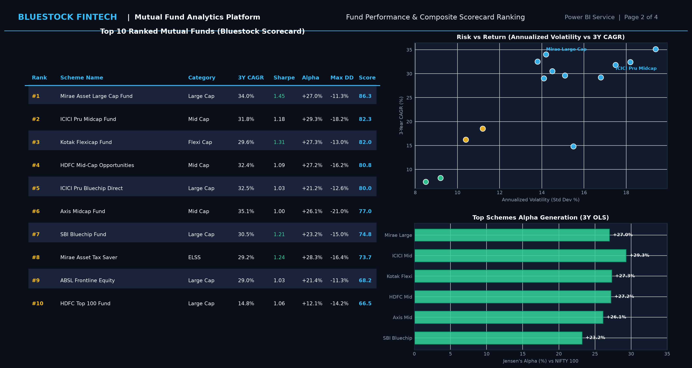
BLUESTOCK FINTECH | DASHBOARD DEPLOYMENT
Power BI Dashboard: Overview & Scorecard Ranks
EXECUTIVE DASHBOARD CAPABILITIES (PAGES 1 & 2)
• Page 1: High-level KPI aggregations (₹81.2L Cr AUM, 40 schemes, ₹31K Cr monthly SIPs) and category breakdown donut.
• Page 2: 100-Point Composite Fund Scorecard ranking table with interactive category slicers and Sharpe risk-return scatter.
Mutual Fund Analytics Capstone | Slide 9 of 12

Slide 10
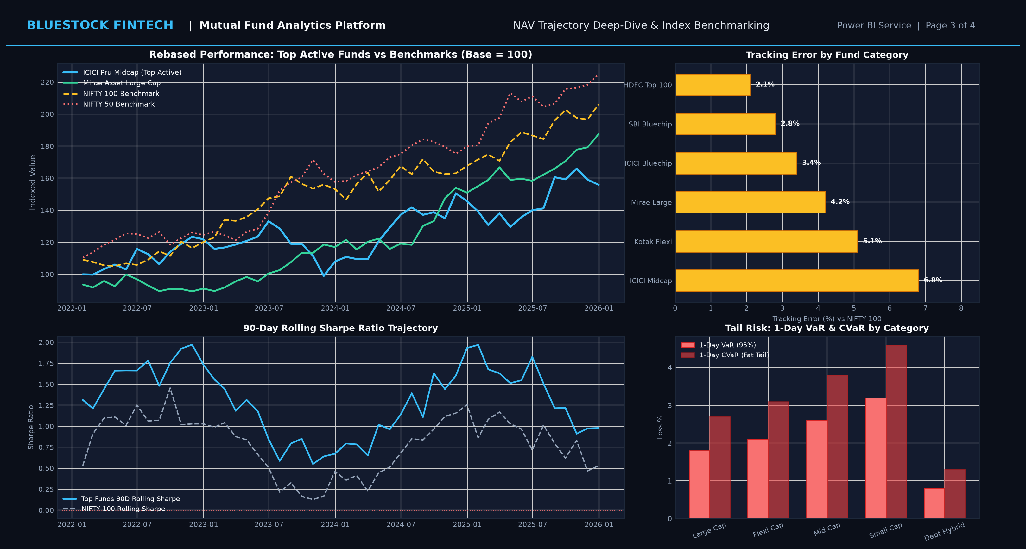
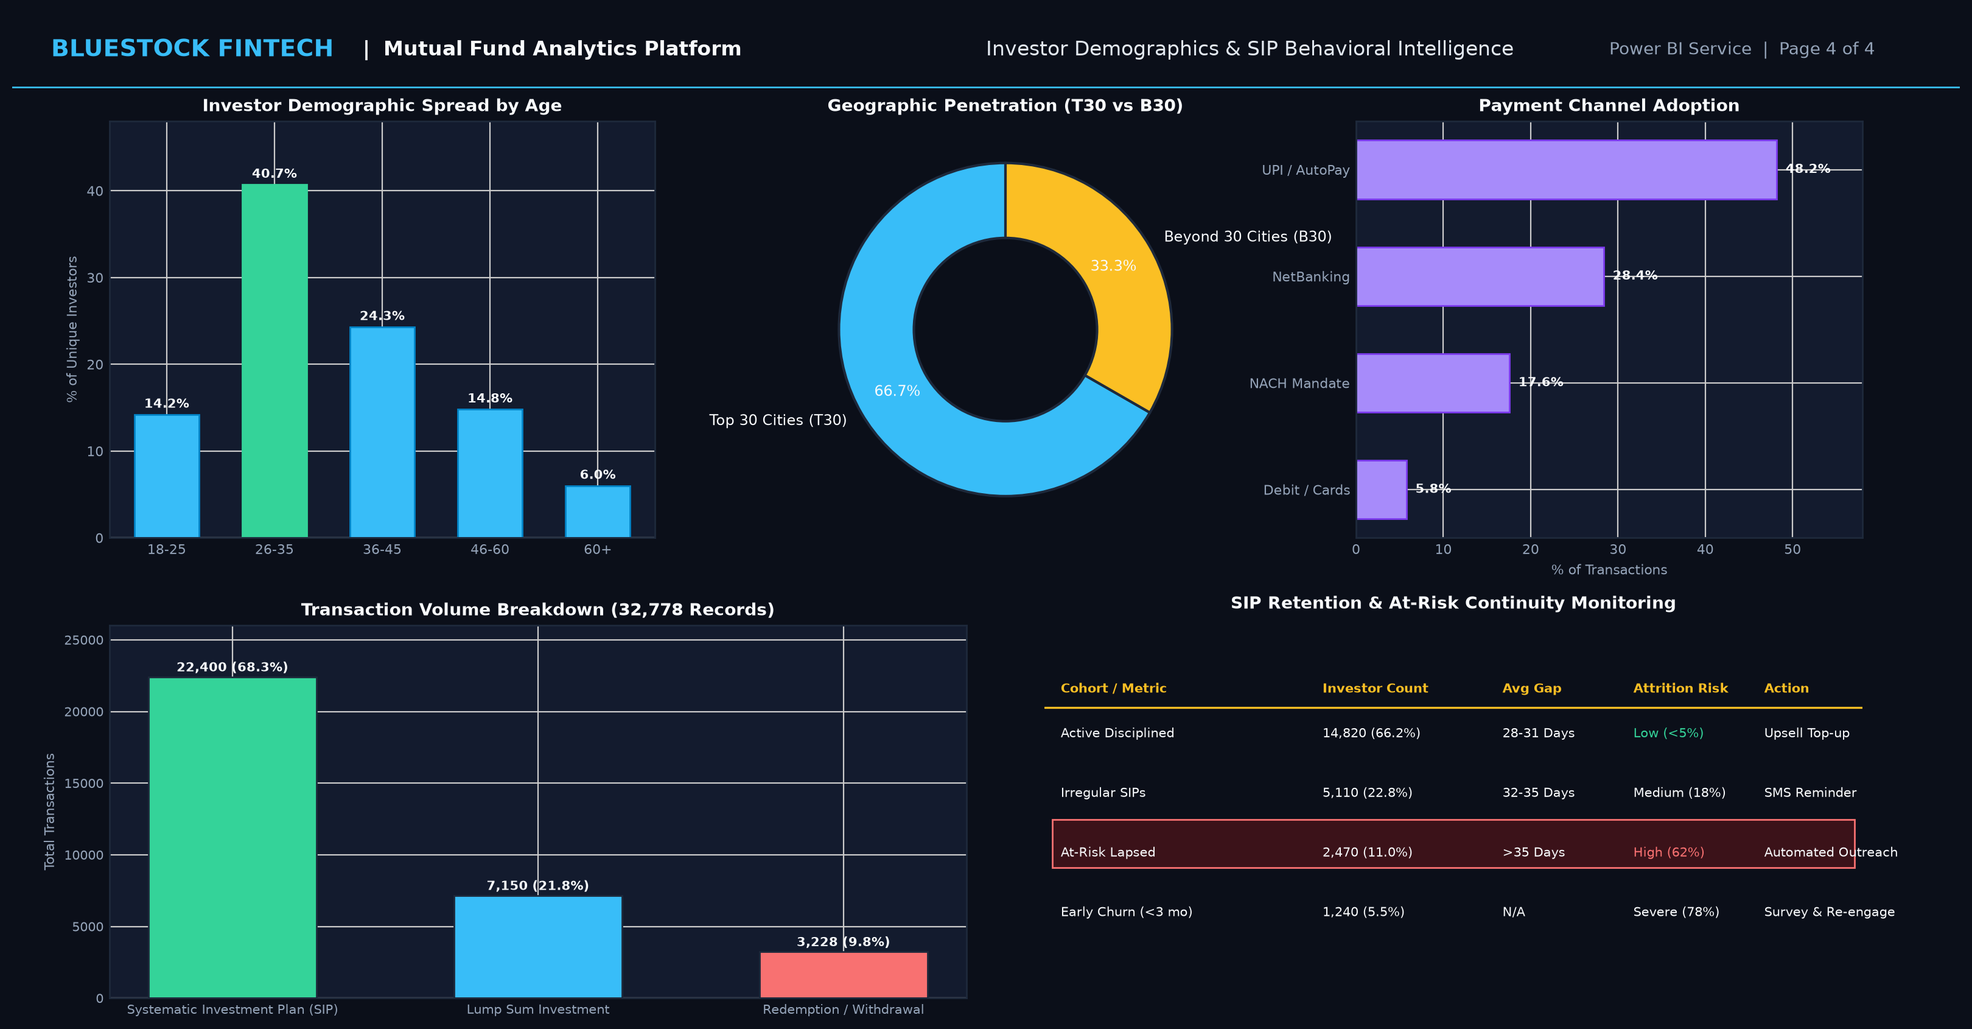
BLUESTOCK FINTECH | DASHBOARD DEPLOYMENT
Power BI Dashboard: NAV Trajectory & SIP Heatmaps
GRANULAR BEHAVIORAL & TIME-SERIES INTELLIGENCE (PAGES 3 & 4)
• Page 3: Rebased historical time-series comparative view vs NIFTY 50/100, 90-day rolling Sharpe dynamics, and tracking error.
• Page 4: Investor age distribution, T30 vs B30 geographic penetration, payment modes (UPI 48.2%), and at-risk SIP drop-off alerts.
Mutual Fund Analytics Capstone | Slide 10 of 12

Slide 11
BLUESTOCK FINTECH | STRATEGIC SYNTHESIS
Key Findings & Strategic Recommendations
FOR INVESTORS
• Stop chasing 1Y returns; rely on composite Scorecard.
• Diversify away from Banking overweight (HHI > 2,750).
• Transition manual monthly SIPs to automated UPI AutoPay for 26% higher compounding.
FOR AMCs / FUND HOUSES
• Implement early retention prompts when SIP contribution gaps exceed 35 days (11% of cohort).
• Expand direct plan distribution into B30 tier-2/3 cities.
• Curate differentiated mid/small cap active strategies to avoid closet indexing.
FOR BLUESTOCK PLATFORM
• Embed rule-based `recommender.py` engine into the core user onboarding experience.
• Schedule automated mfapi.in ingestion pipeline for live weekday NAV and tracking error updates.
• Add portfolio optimization (Markowitz Efficient Frontier) for multi-scheme rebalancing.
Mutual Fund Analytics Capstone | Slide 11 of 12

Slide 12
BLUESTOCK FINTECH
Thank You
Questions & Technical Discussion
GitHub Repository: https://github.com/ashwin4087-a11y/mf-analytics-pipeline (Branch: main | Tag: v1.0)
Dashboard Deployment: bluestock_mf.pbix (Power BI Desktop & Power BI Service)

